Slide 1
TEAS Math Workshop
Part 1: Numbers & Operations

Slide 2
Some introductory notes
The introductory slides are the same for all parts of the workshop.
This workshop is designed to be a comprehensive review of basic math skills and topics that may appear on the TEAS test.
There may be some topics in here that are not covered on the TEAS, and there may be some topics that appear on the TEAS that I did not cover in this workshop. I have never taken the TEAS, but I took some online practice tests and consulted a TEAS prep book for practice and inspiration.
I did my best. If you find any inaccuracies in or have any questions about the workshop, please feel free to email me at jcarter@goodwin.edu.

Slide 3
Some introductory notes
The introductory slides are the same for all parts of the workshop.
In 2020, a colleague and I recorded videos that accompanied this workshop, but they were recorded before the University switched to Canvas. After that switch, the videos were lost.
I have inserted links to videos, websites, and PDFs with practice problems in many of the following slides to make up for the missing videos. The citations for all of these resources are located at the end of this slideshow.
Note:
I am in no way affiliated with the YouTubers or any websites I link in the slideshow. I chose these creators because I like the way they explain math concepts, and I chose the websites because they have a lot of examples (and most have answer keys so you can check your answers).

Slide 4
Some introductory notes
The introductory slides are the same for all parts of the workshop.
If you prefer to work with a tutor or if you want to review a math topic in more depth after completing the workshop, feel free to schedule an appointment with a math tutor! Please come prepared to the appointment with examples to review.
There are also English and science tutors available if you would like to review those subjects. You do not need to be currently enrolled in a math, English, or science course to sign up for TEAS tutoring; you just need to be a current Goodwin student.
Appointments can be on-ground or virtual, but please ensure you read each tutor’s availability carefully so you know if they are on-ground or virtual.

Slide 5
Some introductory notes
The introductory slides are the same for all parts of the workshop.
I know that was a ton of information, and I’m sorry. I just want you to feel as prepared as possible. Some of the videos I linked are pretty long; please don’t feel obligated to watch the whole thing if you don’t need to! I hope you find this workshop helpful.
There is a lot of math to review in here. Remember to take breaks! (I remind you of that a few times throughout the slideshows.)
Now let’s get to the math!
Jenna Carter, Professional Math Tutor

Slide 6

How I’m sure many of you feel
The introductory slides are the same for all parts of the workshop.
But please remember: your mindset can have a HUGE effect on your performance.
Think positively!
For example, instead of thinking, “This is too hard!” think, “With more practice, I will improve!”
[jason701802]. (2010, Aug 19). I'm afraid we need to use...MATH [Video]. YouTube. https://www.youtube.com/watch?v=gENVB6tjq_M

Slide 7
Numbers & Operations
Table of Contents
Sets of Numbers
Prime vs. Composite Numbers
Integers
Operations
Decimals
Scientific Notation
Fractions
Ratios and Proportions
Percentages
Rational Numbers
I know there’s a lot in here. The great things about this workshop are: you can move at your own pace AND you can skip any topics you don’t need to review!
Any text in this slideshow in the pink color shown in the box to the right are links to other slides in this presentation.

Slide 8
Sets of Numbers¹
Any text in that reddish color will take you to videos, sites, or PDFs that will help you as you review!
Natural numbers: numbers that are greater than 0 with no fraction or decimal
  These are also called “counting numbers.”
Whole numbers: natural numbers and the number zero
Integers: positive and negative whole numbers
  We are going to review operations with integers later in the slideshow.
Rational numbers: numbers that can be written as a fraction
  If written as a decimal, they will terminate or repeat.
Irrational numbers: numbers that cannot be represented as a fraction
  If written as a decimal, they will never terminate or repeat.
Real numbers: numbers that can be represented by a point on the number line
  This set includes rational numbers and irrational numbers.

Slide 9
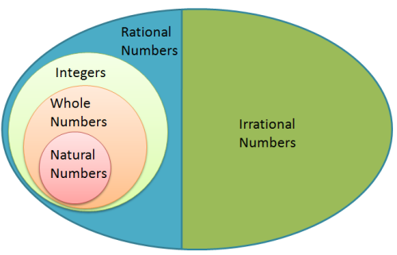
Sets of Numbers
The Real Number System:
The diagram to the right shows how all the sets of numbers from the previous slide are organized within the real number system.
Anything in this small writing is a citation for a picture. You can click the links, but they may just be the web address of the picture in the slide. (This particular website doesn’t exist anymore; I made this slide in 2020.)
Figure 1. Real number system diagram. Adapted from Math and Multimedia by G. Bautista, 2013, retrieved from http://mathandmultimedia.com/2013/08/29/incorrect-real-number-system-diagram/.

Slide 10
Prime vs. Composite Numbers²
Prime numbers: natural numbers (excluding 1) that are only divisible by themselves and 1
  The only even prime number is 2. Every other even number is divisible by 2!
Composite numbers: natural numbers greater than 1 that can be divided by at least one other factor besides 1 and itself
  Factors: numbers that are multiplied by each other to obtain a product
  Composite numbers can be broken down into a prime factorization (see the next slide).

Slide 11
Prime vs. Composite Numbers: Prime Factorization
Prime factorization³: a number written as the product of its prime factors
  In this video, the presenter uses a divisibility rule that he doesn’t explain in the video.
Divisibility rule: a quick way to check if one number is divisible by another number
  Divisibility rules 2 through 5⁴
  Divisibility rules 6 through 10⁵
Look for the orange star in the top right corner to quickly identify slides that have links to practice worksheets.
Practice⁶ for prime factorization.

Slide 12
Prime vs. Composite Numbers: LCM⁷
One application of prime factorization is finding the Least (or Lowest) Common Multiple (LCM) of two or more numbers.
Least (or Lowest) Common Multiple (LCM): the lowest number that two or more numbers divide evenly into
In the video, the presenter uses the notation that lcm(18,12) means the LCM of 18 and 12.
Note:
LCMs are useful when finding lowest (or least) common denominators (LCDs) of fractions, which we will review later in this slideshow.

Slide 13
Prime vs. Composite Numbers: GCF⁸
Another application of prime factorization is finding the greatest common factor (GCF) of two or more numbers.
Greatest common factor (GCF): the largest number that can divide evenly into two or more numbers
  Every combination of numbers will have a GCF. In some cases, the GCF will be 1.
Practice⁹ for finding LCM and GCF.
Note:
GCFs are useful when simplifying fractions, which we will review later in the slideshow.

Slide 14
Prime vs. Composite Numbers: Reminder
This is the end of sets of numbers and prime vs. composite numbers.
If you would like more explanations or practice, feel free to find more worksheets on your own!
If you’d like to return to the Table of Contents slide, click here.

Slide 15
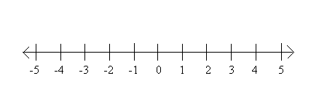
Integers
Positive numbers are greater than 0 while negative numbers are less than 0. Both positive and negative numbers can be represented on a number line.
Performing operations with positive and negative numbers can cause people a lot of grief. We will review the rules in a couple slides.
Figure 2. Number line diagram. Adapted from Inequalities | Graphing Inequalities on a Number Line, retrieved from https://www.sparknotes.com/math/algebra1/inequalities/section4/. Copyright 2025 by SparkNotes LLC.

Slide 16
Integers: Absolute Value¹⁰
But first, super quickly...
Absolute value: the distance a number is from 0 on a number line
  The absolute value of a number will always be positive.
  Absolute value is notated with vertical bars around a number.
| -3 | = 3 = | 3 |
Practice¹¹ for absolute value.

Slide 17
Integers: Addition Rules¹²
Same signs: add the numbers and keep the sign
  Positive + Positive = Positive
  Negative + Negative = Negative
Different signs: subtract the numbers and keep the sign of the number with the larger absolute value
See the next slide for a visual representation of these rules.
Examples: Look at how the answers change when the signs change.
7 + 9 = 16
-7 + (-9) = -16
-7 + 9 = 2
7 + (-9) = -2

Slide 18
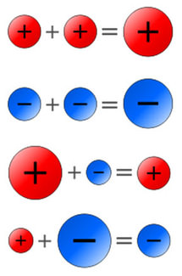
Integers: Addition Rules
Note the sizes and colors of the circles in the image to the right.
The bigger circles represent the numbers with higher absolute values.
In the third row, the positive number has a larger absolute value, so the answer is positive.
In the fourth row, the negative number has a larger absolute value, so the answer is negative.
Figure 3. Adding integers. Adapted from Subtracting Integers (Directed Numbers), 2017, retrieved from https://www.ck12.org/user:bs10zwftqgljc3ouy2g./book/integrated-mathematics-ii-myp2/section/2.5/. Copyright 2025 by CK-12 Foundation.

Slide 19
Integers: Addition Rules
Don’s* trick for addition of integers:
If you have the same signs, you take the sum and keep the sign.
If you have different signs, you take the difference then keep the sign of the number with the larger absolute value.
* Don used to be a math tutor at Goodwin. He helped plan this workshop!
☆ Pro Tip ☆
To make this trick easier to remember, think:
Same sign: sum
Different signs: difference

Slide 20
Integers: Subtraction Rules¹³
Instead of memorizing another rule for subtraction, I suggest thinking of subtraction as “adding the opposite.”
Here’s how to add the opposite:
Change the subtraction to addition.
Change the sign of the second number.
Use the addition rules from the previous two slides.
Examples: Look at how the answers change when the signs change.
7 − 9 = 7 + (-9) = -2
-7 − (-9) = -7 + 9 = 2
-7 − 9 = -7 + (-9) = -16
7 − (-9) = 7 + 9 = 16

Slide 21
Integers: Addition and Subtraction Practice
Practice¹⁴ for adding and subtracting integers.
☆ Pro Tip ☆
When adding and subtracting integers, think of money.
Positive numbers = money you have
Negative numbers = money you owe

Slide 22
Integers: Multiplication and Division Rules¹⁵
Luckily, the rules for multiplication and division of integers are the same.
If you are multiplying or dividing an odd number of negatives, your answer will be negative.
If you are multiplying or dividing an even number of negatives, your answer will be positive.
Practice¹⁶ for multiplying and dividing integers.
Examples: Look at how the answers change when the signs change.
8 × 2 = 16 8 ÷ 2 = 4
-8 × (-2) = 16 -8 ÷ (-2) = 4
8 × (-2) = -16 8 ÷ (-2) = -4
-8 × 2 = -16 -8 ÷ 2 = -4

Slide 23
Integers: Reminder
That’s it for integers!
Remember: It is important to take breaks when studying.
If you’d like to return to the Table of Contents slide, click here.

Slide 24

Operations
Operation: an action that you perform on numbers
The four basic operations are addition, subtraction, multiplication, and division.
The Order of Operations also takes into account parentheses and exponents.
We will review exponents (and roots) on the next few slides.
Figure 4. Operations spiral. Adapted from Introduction to Mathematical Operations, 2021, retrieved from https://www.cuemath.com/learn/maths-olympiad-mathematical-operations/.

Slide 25
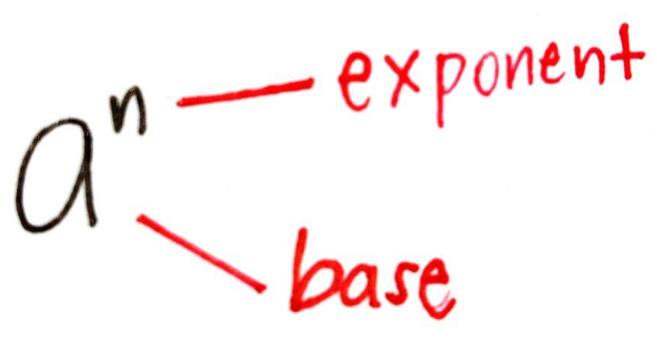
Operations: Exponents¹⁷
Exponent: a number that is written above a base and represents repeated multiplication (the number of times the base is used as a factor)
There are a couple of special exponents:
Zero: any nonzero base to the power of 0 is 1
  Examples: 4⁰ = 1, (-6)⁰ = 1, 3.5⁰ = 1
One: any numerical base to the power of 1
stays the same
  Examples: 4¹ = 4, (-6)¹ = -6, 3.5¹ = 3.5
There are lots of rules for exponents; they are on the
next couple slides.
Figure 5. Base and exponent. Adapted from Laws of Exponent by Jolina B. Cabria, 2024, retrieved from https://discover.hubpages.com/education/laws-of-exponent. Copyright 2025 by The Arena Media Brands, LLC.

Slide 26
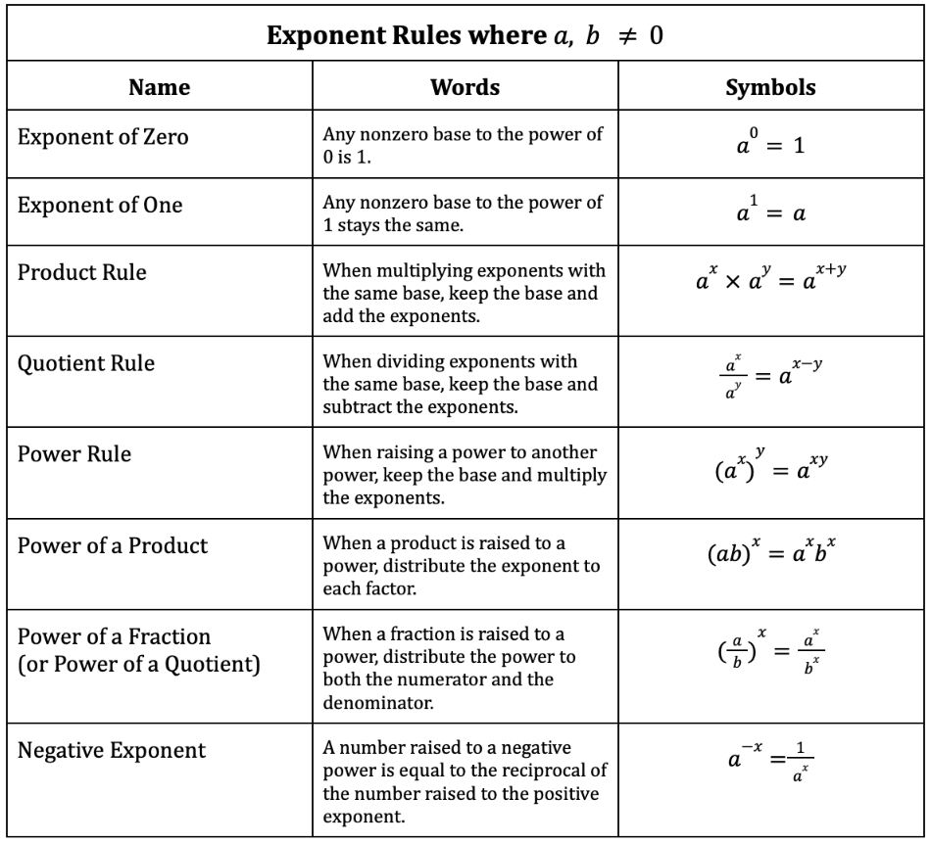
Operations: Exponent Rules for a ≠ 0, b ≠ 0
Here is a chart of exponent rules. There are links to videos of most of the rules on the next slide.
Figure 6. Exponent rules. Screenshot taken from TEAS Math Materials, Google Doc by Jenna Carter, 2025.

Slide 27
Operations: Exponent Rules for a ≠ 0, b ≠ 0
Product Rule¹⁸
Quotient Rule¹⁹
Power Rule²⁰
Power of a Product²¹
Power of a Fraction²²
Negative Exponents²³
Practice²⁴ for exponent rules.

Slide 28
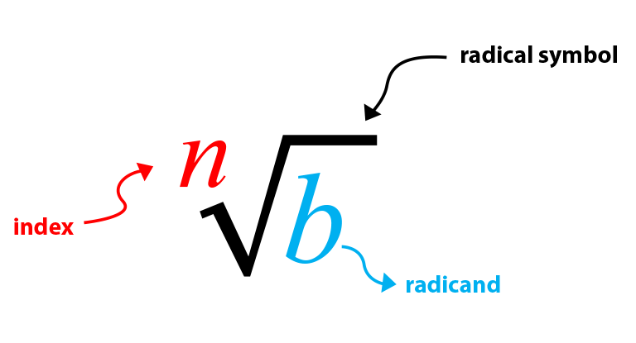
Operations: Roots
Taking a root of a number is the opposite (or inverse) of raising a number to an exponent.
You can take roots with any numerical index, but for the TEAS, you will only need to know square roots (see the next slide). Square roots have an index of 2.
If you see a radical symbol without an index, it is understood that you are taking a square root.
Figure 7. Parts of a root. Adapted from How to Simplify Square Roots?, 2020, retrieved from https://calcworkshop.com/radicals/square-root/. Copyright 2025 by Calcworkshop LLC.

Slide 29
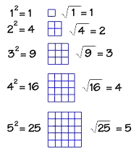
Operations: Square Roots²⁵
Square root: a factor of a number that when squared gives the number
Example: 7² = 49 so √49 = 7
Practice²⁶ for finding square roots.
Note:
When raising a number to the exponent 2, we can say that the number is squared. That is why, when the index of a root is 2, we say we are taking the square root.
Figure 8. Square roots. Adapted from Squares and Square Roots, retrieved from http://www.math.com/school/subject3/lessons/S3U3L3DP.html. Copyright 2005 by Math.com.

Slide 30
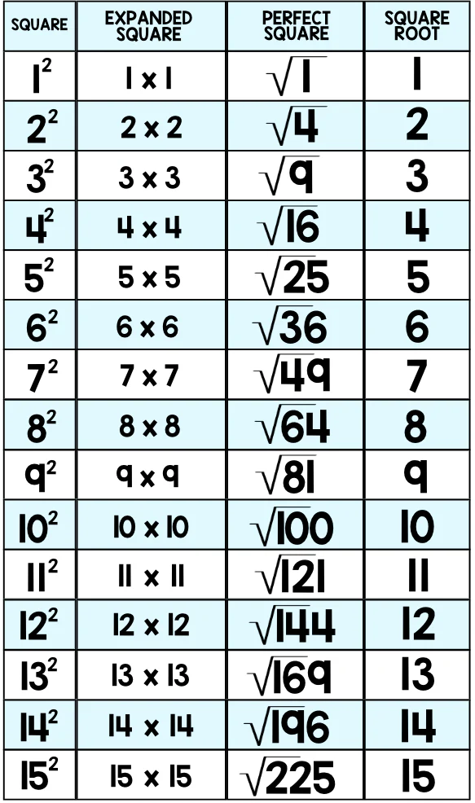
Operations: Perfect Squares
Going back to the example from the previous slide:
7² = 49 so √49 = 7
Because the square root of 49 is a whole number, we say that 49 is a perfect square.
The chart to the right shows the first 15 perfect squares and their square roots (it might be a good idea to memorize these).
Figure 9. Perfect squares and their square roots. Adapted from Building Perfect Squares Activity, retrieved from https://sproutingtadpoles.com/products/building-perfect-square-roots?srsltid=AfmBOoqWyBzGAvmeRProYSJyEQkGaFtYyGzDf2OUMZ8oIzirfwSDhwil. Copyright 2025 by Sprouting Tadpoles.

Slide 31
Operations: Properties & Inverses
Properties:
Commutative Property²⁷
  of Addition: a + b = b + a
  of Multiplication: ab = ba
Associative Property²⁸
  of Addition: (a + b) + c = a + (b + c)
  of Multiplication: (ab)c = a(bc)
Identity Property²⁹
  of Addition: a + 0 = a
  of Multiplication: a × 1 = a
Distributive Property³⁰
a(b + c) = ab + ac
Inverses:
Additive Inverse³¹
(or opposite):
a + (-a) = 0
Multiplicative Inverse³²
(or reciprocal):
a × (1/a) = 1
Note:
Inverses will come in handy when solving equations (check out Part 2 of the workshop).

Slide 32
Operations: Order of Operations³³
“Please Excuse My Dear Aunt Sally!” or PEMDAS
P : Parentheses (or grouping symbols)
E : Exponents
MD : Multiplication and Division
(in order from left to right)
AS : Addition and Subtraction
(in order from left to right)
Note:
You DO NOT always do multiplication before division, and you DO NOT always to addition before subtraction!

Slide 33
Operations: Order of Operations
Practice³⁴ for order of operations.
Note: -3² ≠ (-3)²
Use the order of operations!
Do exponents before subtraction, so -3² means multiply 3 by itself and then apply the negative.
-3² = -(3 × 3) = -9
Do parentheses before exponents, so (-3)² means multiply -3 by itself.
(-3)² = (-3)(-3) = 9

Slide 34
Operations: Reminder
You have reached the end of the operations section.
If you’d like to return to the Table of Contents slide, click here.

Slide 35
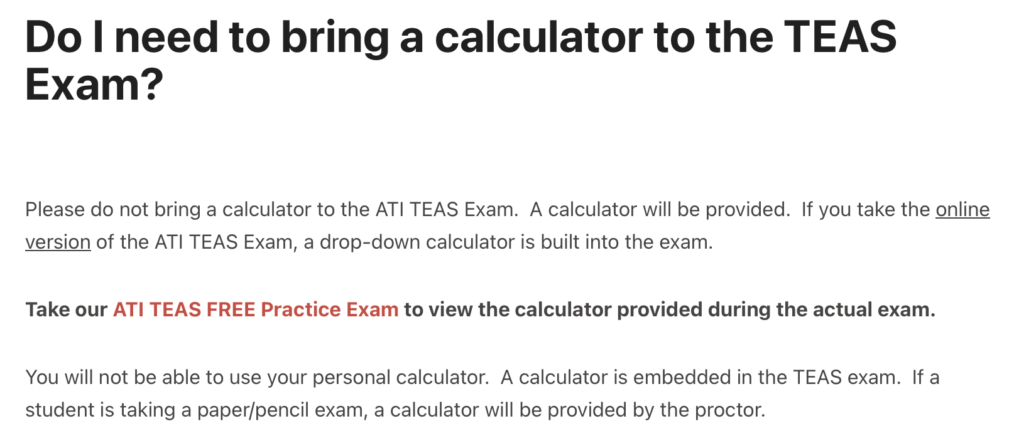
Decimals
Decimal: a number that contains a decimal point
Decimals can be added, subtracted, multiplied, or divided.
There will be a basic calculator on the TEAS test, so I will not review these operations at this time.
Figure 10. Do I need to bring a calculator? Adapted from Do I need to bring a calculator to the TEAS Exam?, retrieved from https://help.atitesting.com/do-i-need-to-bring-a-calculator/. Copyright 2025 by Assessment Technologies Institute, LLC.

Slide 36
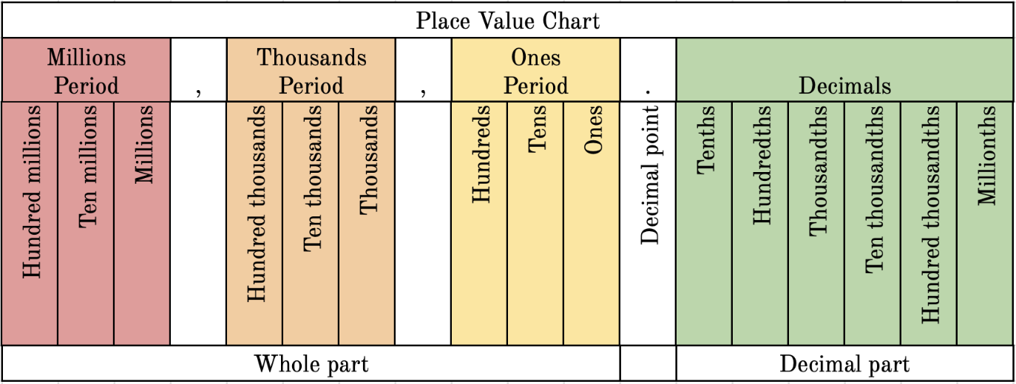
Decimals: Place Value³⁵
Figure 11. Place value chart. Screenshot taken from TEAS Math Place Value Chart, Google Sheet by Jenna Carter, 2025.

Slide 37
Decimals: Rounding
Rounding: simplifying a complicated number
The resulting number will be less precise but easier to work with.
The place value you need to round to will usually be stated for you.
There are two videos for you to watch: rounding whole numbers³⁶ and rounding decimals³⁷.
Here’s how to round:
Underline the place being rounded to.
Look at the digit one place to the right, and decide whether to round the number up or down.
  5 or more, raise the score!
  4 or less, let it rest!
Practice for rounding whole numbers³⁸ and rounding decimals³⁹.

Slide 38
Decimals: Estimation
Estimation: the process of rounding numbers and then performing an operation with them
We estimate when we are working with large numbers and want to find a close answer, but not the exact answer.
Videos for estimating sums and differences⁴⁰, products⁴¹, and decimal quotients⁴².
☆ Pro Tip ☆
Estimation can often be used to eliminate answer choices for multiple choice questions without having to completely solve the problem!
Practice for estimating sums⁴³, products⁴⁴, and quotients⁴⁵ (answers on the next two slides).

Slide 39
Decimals: Estimation Answers (Slide 1 of 2)
Answers to Estimating Sums:
12,000
31,000
106,000
9,000
22,000
159,000
13,000
47,000
66,000
10,000
7,000
27,000
Answers to Estimating Products:
80
280
250
90
630
540
60
150
350
100
160
40
Please let me know if I made any mistakes!

Slide 40
Decimals: Estimation Answers (Slide 2 of 2)
Answers to Estimating Quotients:
Part A: (I looked for the numerator answer that was closest to the original numerator)
c
d
a
b
Part B: (I left the denominator and rounded the numerator so that I could get a whole number answer)
d
a
c
b
Please let me know if I made any mistakes!

Slide 41
Decimals: Reminder
That was the last slide in the decimals section.
If you’d like to return to the Table of Contents slide, click here.

Slide 42
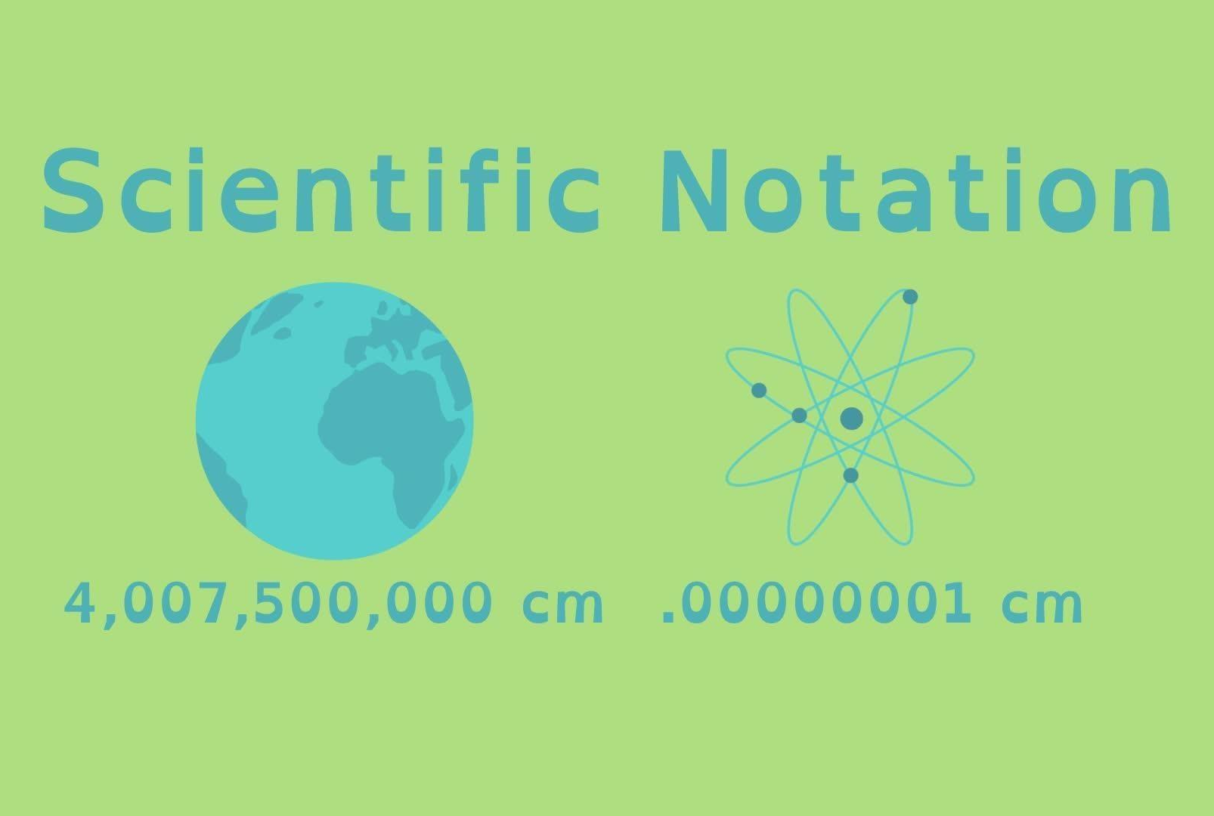
Scientific Notation⁴⁶
Scientific notation: a method of representing very large and very small numbers
A number written in scientific notation will be of the form:
a×10^{n}
where 1 ≤ a < 10 and n is a nonzero integer.
Figure 12. Scientific notation. Adapted from Scientific Notation, 2022, retrieved from https://cptv.pbslearningmedia.org/resource/muen-math-ee-scientificnotation/scientific-notation/. Copyright 2025 by PBS & WGBH Educational Foundation.

Slide 43
Scientific Notation: Convert to Scientific Notation
Converting from decimal notation to scientific notation⁴⁷:
Identify where the decimal point needs to be so that 1≤ a <10.
Start from where the decimal point is, and move left or right until you have the desired a value.
The number of places you moved will be the exponent on 10.
  If you move the decimal point left, you will have a positive exponent.
  If you move the decimal point right, you will have a negative exponent.
Practice⁴⁸ for converting to scientific notation.

Slide 44
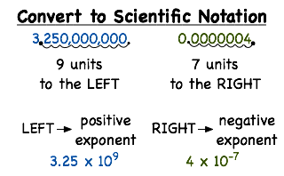
Scientific Notation: Convert to Scientific Notation
Notes:
When converting to scientific notation…
If you are making the number smaller to become the coefficient (like the example on the left), the power of 10 will be large (positive).
If you are making the number larger to become the coefficient (like the example on the right), the power of 10 will be small (negative).
Figure 13. Convert to scientific notation. Adapted from Converting Fractions to Scientific Notation, retrieved from https://www.assignmentpoint.com/science/mathematic/converting-fractions-to-scientific-notation.html. Copyright 2025 by Assignment Point.

Slide 45
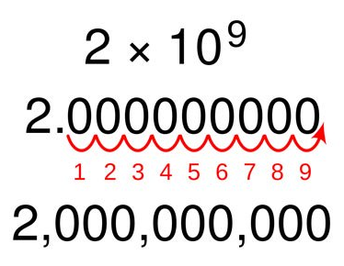
Scientific Notation: Convert to Decimal Notation
Converting from scientific notation to decimal notation⁴⁹:
Start from where the decimal point is and move the decimal point the same number of times as the exponent.
  Positive exponent: move to the right
  Negative exponent: move to the left
Place the new decimal point.
Fill in any bumps with zeroes.
Practice⁵⁰ for converting to decimal notation.
Figure 14. Scientific notation to decimal notation. Adapted from Scientific Notation, retrieved from https://beccaandstephaniechemisty.weebly.com/scientific-notation.html.

Slide 46
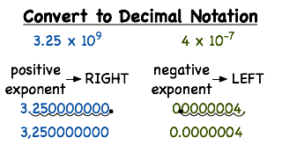
Scientific Notation: Convert to Decimal Notation
Notes:
When converting to decimal notation…
If your exponent on 10 is positive (like the example on the left), you will move the decimal point to the right to make the coefficient larger.
If your exponent on 10 is negative (like the example on the right), you will move the decimal point to the left make the coefficient smaller.
Figure 15. Convert to decimal notation. Adapted from How Do You Convert From Scientific Notation to Decimal Notation?, retrieved from https://virtualnerd.com/worksheetHelper.php?tutID=Alg1_6_1_20.

Slide 47
Scientific Notation: Addition and Subtraction⁵¹
The powers of ten MUST be the same to add or subtract numbers in scientific notation.
How to proceed based on your powers of 10:
If you have the same powers of 10, add or subtract the a terms and keep the exponent. Ensure your answer is in scientific notation!
If you have different powers of 10, convert the smaller exponent to the larger exponent, then add or subtract. Ensure your answer is in scientific notation!
Practice⁵² for addition and subtraction in scientific notation.

Slide 48
Scientific Notation: Multiplication and Division⁵³
The powers of ten DO NOT have to be the same to multiply or divide numbers in scientific notation.
The processes summed up:
If you are multiplying, multiply the coefficients and then add the powers of 10. Ensure your answer is in scientific notation!
If you are dividing, divide the coefficients and then subtract the powers of 10. Ensure your answer is in scientific notation!
Practice for multiplication⁵⁴ and division⁵⁵ in scientific notation.

Slide 49
Scientific Notation: Don’s notes
If you are doing addition or multiplication, you may end up with a value greater than 10 for your a term. If that happens, you need to convert your answer into scientific notation by making the coefficient smaller and the power of 10 larger.
If you are doing subtraction or division, you may end up with a value less than 1 for your a term. If that happens, you need to convert your answer into scientific notation by making the coefficient larger and the power of 10 smaller.

Slide 50
Scientific Notation: Reminder
That’s all I have for scientific notation.
I hope you are doing well with the workshop so far! I know it’s a lot of work, but just keep thinking about your goals.
If you’d like to return to the Table of Contents slide, click here.

Slide 51
Fractions: Vocabulary⁵⁶ (Slide 1 of 2)
Fractions: numbers that can be written as a/b, where b ≠ 0
  Fractions compare a part to a whole.
Numerator (a): the top number of a fraction (“the part”)
Denominator (b): the bottom number of a fraction (“the whole”)
Proper fraction: a fraction whose numerator is less than the denominator
Improper fraction: a fraction whose numerator is greater than or equal to the denominator
Mixed number: a number which has a whole number part and a fraction part
a
b

Slide 52

Fractions: Vocabulary (Slide 2 of 2)
Equivalent fractions: fractions that have different numerators and denominators but have the same value
Simplified fraction (lowest terms): the greatest common factor between the numerator and denominator is 1
Like fractions: fractions that have a common denominator
Unlike fractions: fractions that do not have a common denominator
Note:
Fraction bars are one of the symbols that represent division.
This fraction means “3 divided by 4.”
Figure 16. Three-fourths. Retrieved from https://www.pngkey.com/maxpic/u2q8r5o0a9q8a9r5/.

Slide 53
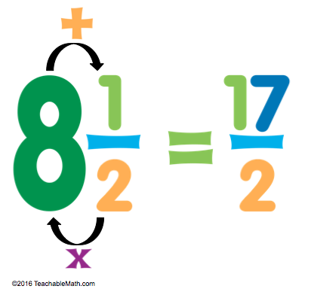
Fractions: Mixed Numbers and Improper Fractions
How to convert a mixed number to an improper fraction⁵⁷:
The Steps:
Multiply the denominator by the whole number.
Add the numerator.
Keep the denominator.
Practice⁵⁸ for converting mixed numbers to improper fractions.
Figure 17. Mixed number to improper fraction. Adapted from Mixed Numbers and Improper Fractions, retrieved from https://teachablemath.com/mixed-numbers-improper-fractions/. Copyright 2025 by TeachableMath.

Slide 54
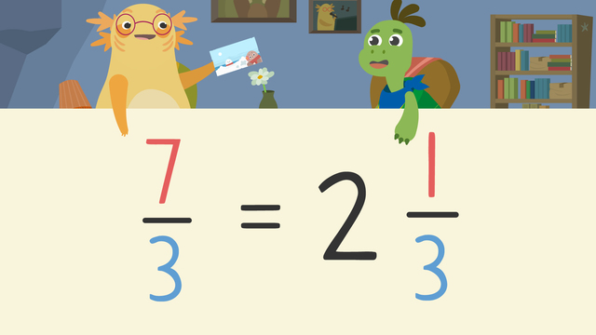
Fractions: Mixed Numbers and Improper Fractions
How to convert an improper fraction to a mixed number⁵⁹:
The Steps:
Divide the numerator by the denominator.
The quotient becomes the whole number.
The remainder becomes the numerator of the fraction, and the denominator stays the same.
Practice⁶⁰ for converting improper fractions to mixed numbers.
Figure 18. Improper fraction to mixed number. Adapted from Improper Fractions and Mixed Numbers, retrieved from https://us.sofatutor.com/math/videos/improper-fractions-and-mixed-numbers.

Slide 55
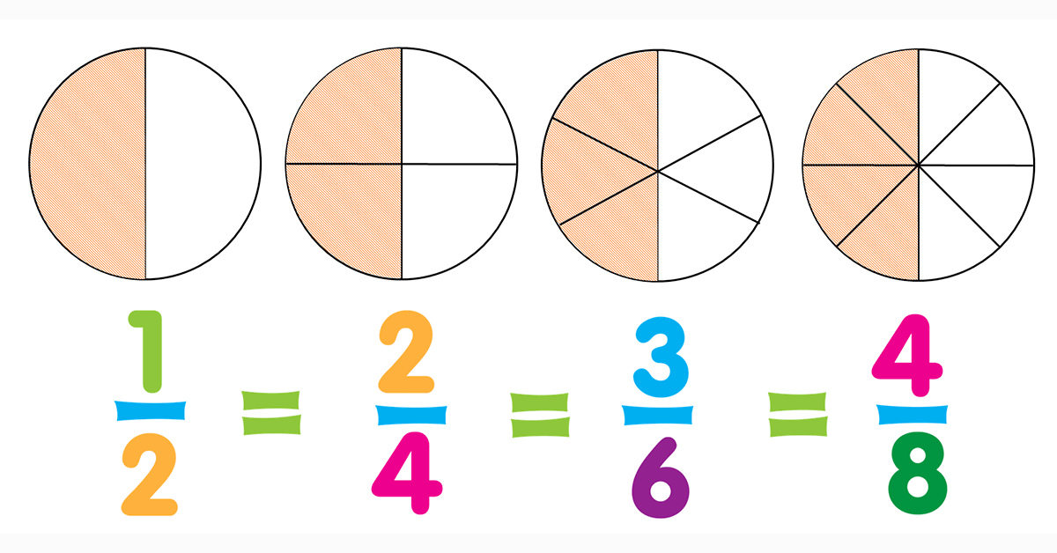
Fractions: Simplifying Fractions⁶¹
When answering fraction problems, you will often be told to answer “in simplest terms” or “in lowest terms.” This means you must simplify the fraction so that there is no common factor between the numerator and the denominator.
In the picture to the right, there are four equivalent fractions which all represent the same value, but ½ is in simplest terms.
Practice⁶² for simplifying fractions.
Figure 19. Equivalent fractions. Adapted from Teaching Equivalent Fractions by Tze-Ping Low, retrieved from https://teachablemath.com/teaching-equivalent-fractions/. Copyright 2025 by TeachableMath.

Slide 56
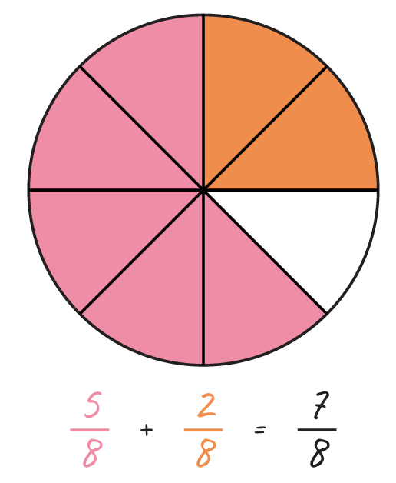
Fractions: Addition and Subtraction
To add or subtract fractions, you MUST have a common denominator.
If you already have fractions with a common denominator, just add⁶³ or subtract⁶⁴ the numerators, and keep the denominator the same. After you perform the operation, simplify if possible.
The process for addition and subtraction with unlike denominators is on the next slide.
Figure 23. Adding fractions. Adapted from Adding and Subtracting Fractions, 2020, retrieved from https://calcworkshop.com/fractions/adding-subtracting-fractions/. Copyright 2025 by Calcworkshop LLC.

Slide 57
Fractions: Addition and Subtraction
To add or subtract fractions, you MUST have a common denominator.
If you have unlike fractions, you have two choices to find a common denominator:
Calculate lowest common denominator by finding the LCM of the denominators.
  Lowest (or least) common denominator (LCD): the least common multiple (LCM) of the denominators of several fractions
List multiples⁶⁵ of each denominator until you find the LCD.
Once you have the LCD, follow the steps from the previous slide to add or subtract. Here are some addition and subtraction⁶⁶ examples from beginning to end.
Practice⁶⁷ for adding and subtracting fractions.

Slide 58
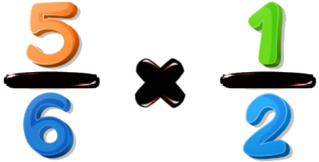
Fractions: Multiplying Fractions⁶⁸
To multiply fractions, multiply the numerators then multiply the denominators. Then simplify if possible.
☆ Pro Tip ☆
Before multiplying or dividing, see if you can simplify (cross cancel) anything. It will save you a lot of work!
Figure 20. Multiplying fractions. Adapted from Multiplying/Dividing Fractions, retrieved from https://www.mymathta.com/courses/multiplying-dividing-fractions/. Copyright 2025 by MathTA.

Slide 59

Fractions: Dividing Fractions (Two Ways)
The first way to divide fractions is Keep-Change-Flip⁶⁹ (the presenter in the video says “Keep-Switch-Flip,” but I like Keep-Change-Flip because of the letters).
Not KFC, but KCF.
Keep the first fraction.
Change the division to
multiplication.
Flip the second fraction.
Now you have a multiplication problem. You know this!
The second way is to multiply by the reciprocal⁷⁰.
Both ways mean the same thing, and you will get you the same answer. Use whichever way is easiest to remember!
Practice⁷¹ for multiplying and dividing fractions.
Figure 21. KFC logo. Adapted from KFC, retrieved from https://en.wikipedia.org/wiki/KFC.

Slide 60
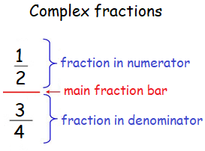
Fractions: Dividing Fractions (Alternate Notation)
If you see a complex fraction like in the example to the right, don’t panic!
Complex fraction: a fraction in which the numerator, the denominator, or both contain another fraction
Recall that fraction bars represent division. You can rewrite that complex fraction as ½ ÷ ¾, then you can Keep-Change-Flip that expression to get ½ × ¾. Now just multiply then simplify!
Figure 22. Complex fractions. Adapted from Simplifying Complex Rational Expressions, retrieved from https://www.onlinemath4all.com/simplifying-complex-rational-expressions.html. Copyright onlinemath4all.com.

Slide 61

Fractions: Reminder
Note:
Where you put the negative sign in a fraction doesn’t really matter.
These all mean the same thing, but the first way is most common.
That’s it for fractions! Just review the note to the right for negative fractions.
Remember to search for more review videos if you would still like more guidance or support!
If you’d like to return to the Table of Contents slide, click here.
Figure 24. Negative fractions. Screenshot taken from TEAS Math Materials, Google Doc by Jenna Carter, 2025.

Slide 62
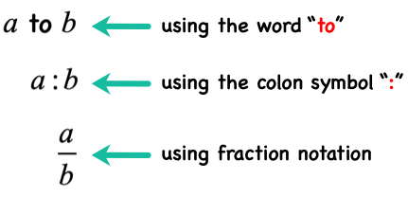
Ratios and Proportions: Ratios⁷²
Ratio: a comparison of two or more numbers that can be represented in three ways:
With the word “to”
With a colon
As a fraction
Figure 25. Kinds or types of ratios. Adapted from Ratios, retrieved from https://www.chilimath.com/lessons/introductory-algebra/ratios/. Copyright 2025 by ChiliMath.com.
Note:
In a ratio, the numbers represent a constant relationship, not necessarily specific values.

Slide 63
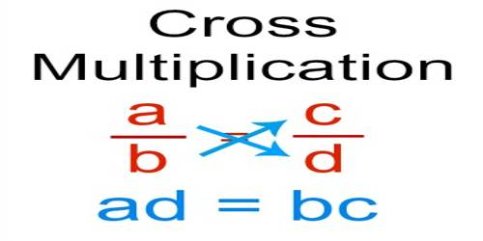
Ratios and Proportions: Proportions
Proportion: an equation which states that two ratios are equal
Proportions are solved by using cross multiplication⁷³ (see the image below).
A proportion MUST have the same units in both numerators and both denominators.
Practice⁷⁴ for solving proportions.
Figure 26. Cross multiplication. Adapted from Cross Multiplication to Solve Proportions, retrieved from https://www.assignmentpoint.com/science/mathematic/cross-multiplication-solve-proportions.html. Copyright 2025 by Assignment Point.
Note:
A key phrase associated with proportion problems is “is to.”

Slide 64

Ratios and Proportions: Unit Rate⁷⁵
A common application of proportions is calculating a unit rate.
Unit rate: a comparison of how many units of one type correspond to 1 unit of the another type
Practice⁷⁶ for calculating unit rates.
Note:
A key phrase of unit rate problems is “(first unit) per (second unit).” Some common unit rates are miles per hour, cost per item, and earnings per week.
Figure 27. Speed limit 40. Retrieved from https://www.1001freedownloads.com/free-clipart/speed-limit-40.

Slide 65
Ratios and Proportions: Unit Rate
You may (or may not) be asked a question like this (answer on the next slide).
If a 100-pack of latex gloves from one brand costs $5.99 and a 350-pack of latex gloves from another brand costs $22.99, determine which gloves are a better price.

Slide 66
Ratios and Proportions: Reminder
Answer to question from previous slide:
The 100-pack is the better price ($0.06 per glove vs. $0.07 per glove).
If you’d like to return to the Table of Contents slide, click here.

Slide 67
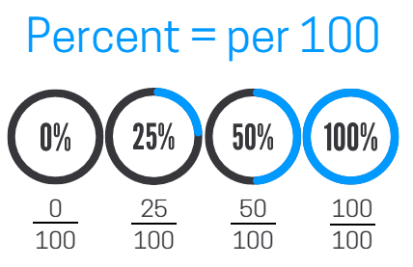
Percentages⁷⁷
Percent (or percentage): means “per hundred” and is expressed with a percent symbol (%)
☆ Pro Tip ☆
To remember the definition, break apart the word “percent.”
Per- means divide, and -cent means 100. Percent means “divided by 100.”
Figure 28. Percent = per 100. Adapted from How to Find the Percent of a Number, retrieved from https://www.1001freedownloads.com/free-clipart/speed-limit-40. Copyright 2021 by Kate’s Math Lessons.

Slide 68
Percentages: First Way to Solve
There are a couple of different formulas you can use to solve percentage problems. I will show you both ways, but you can use whichever one makes most sense to you!
The first way is using a
formula with a decimal⁷⁸.
R × B = A
where R is the percent written as a decimal, B is the base (or whole), and A is the amount (or part).
Note:
In percentage questions, the base will usually follow the word “of,” and the amount will usually follow the word “is.”

Slide 69
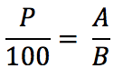
Percentages: Second Way to Solve
There are a couple of different formulas you can use to solve percentage problems. I will show you both ways, but you can use whichever one makes most sense to you!
The second way is using a
formula with a proportion⁷⁹.
In the video, the presenter uses
“is over of” instead of “A over B.”
(See my note on the previous slide!)
Practice⁸⁰ for finding percents.
where P is the percent, A is the amount (or part; the “is”), and B is the base (or whole; the “of”).
Figure 29. Percent. Screenshot taken from TEAS Math Materials, Google Doc by Jenna Carter, 2025.

Slide 70
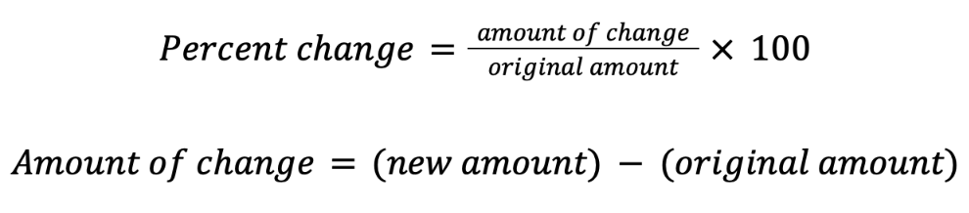
Percentages: Percent Change⁸¹
Percent change problems involve a change from an original amount.
The formula for percent change is in the orange box.
Practice⁸² for percent change.
Figure 30. Percent change formulas. Screenshot taken from TEAS Math Materials, Google Doc by Jenna Carter, 2025.
Note:
Key terms associated with percent change problems include “discount,” “sales tax,” and “markup.”

Slide 71
Percentages: Reminder
That’s it for the percentages part of the slideshow.
If you’d like to return to the Table of Contents slide, click here.

Slide 72
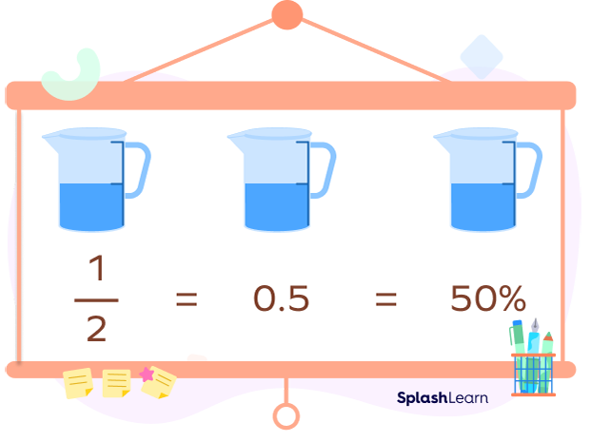
Rational Numbers
What you may be asked to do with rational numbers:
Convert between forms (percents, fractions, decimals)
Compare by value
Order from least to greatest (or greatest to least)
We will review all of these processes in the next few slides.
Figure 31. Forms of rational numbers. Adapted from Converting Fractions to Percent: Steps, Formula, Table, Examples, FAQs, retrieved from https://www.splashlearn.com/math-vocabulary/fraction-to-percent.

Slide 73
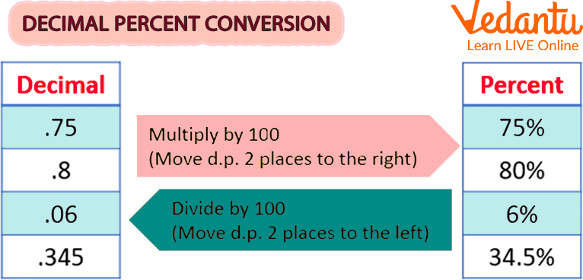
Rational Numbers: Converting between Forms
Let’s start with the easiest conversions among rational numbers: decimals to percents⁸³ and percents to decimals⁸⁴.
When converting between these forms, all you need to do is move the decimal point two places to the left or two places to the right. You just have to remember which way to go! (See my note on the next slide.)
Figure 32. Decimal percent conversion. Adapted from Step-by-Step Guide: Decimal to Percent Conversion, retrieved from https://www.vedantu.com/maths/convert-decimal-to-percentage. Copyright 2025 by Vedantu.com.
Practice⁸⁵ for converting between decimals and percents.

Slide 74
Rational Numbers: Converting between Forms
The other day, I noticed that a percent symbol looks like a rotated division symbol. Maybe that can help you remember that to get from percent to decimal form, you divide the percent by 100!
75 = 75 100
If that helps, that’s great! If not, don’t worry about it.

Slide 75
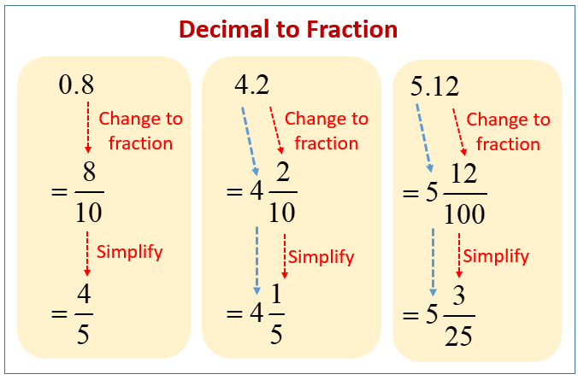
Rational Numbers: Converting between Forms
For fraction to decimal, divide the numerator by the denominator. That’s it!
For decimal to fraction⁸⁶, put the decimal over the appropriate base-10 power, then simplify if possible.
The denominator should have as many zeroes as there are decimal places in the original value.
Practice for converting fractions to decimals⁸⁷ and converting decimals to fractions⁸⁸.
Figure 33. Decimal to fraction. Adapted from Decimals to Fractions, retrieved from https://www.onlinemathlearning.com/decimal-to-fraction.html. Copyright 2025 by OnlineMathLearning.com.

Slide 76
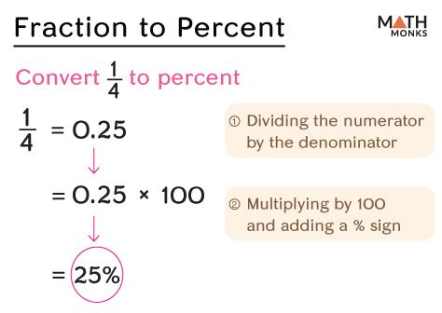
Rational Numbers: Converting between Forms
For fraction to percent⁸⁹, I go through decimal form. I convert from fraction form to decimal form then go to percent form.
Fraction to percent:
Convert the fraction to a decimal.
  In the video, the presenter uses long division for the first example only.
Convert the decimal to a percent.
Practice⁹⁰ for converting fractions to percents.
Figure 34. Fraction to percent. Adapted from Fraction to Percent, retrieved from https://mathmonks.com/fractions/fraction-to-percent Copyright 2025 by Mathmonks.com.

Slide 77
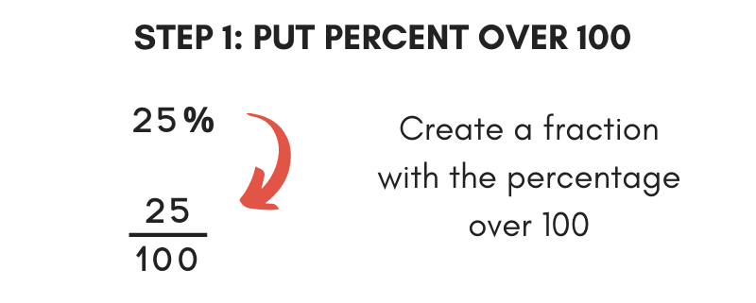
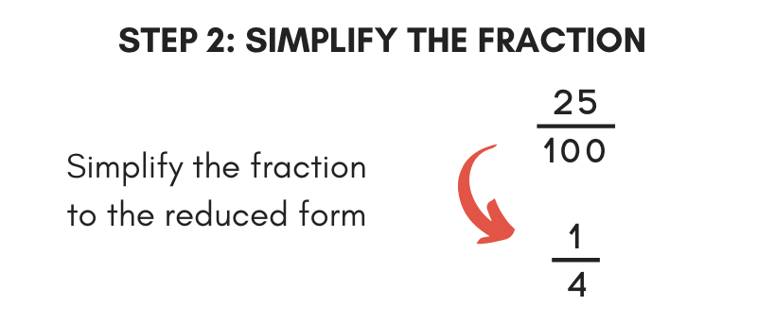
Rational Numbers: Converting between Forms
For percent to fraction⁹¹, there are two ways:
Put the percent over 100, then simplify the fraction.
Go through decimal form using these steps:
  Convert the percent to a decimal.
  Convert the decimal to a fraction.
Practice⁹² for converting percents to fractions.
Figure 35. Convert a percent to fraction. Adapted from Percent to Fraction Calculator by Joe Sexton, retrieved from https://www.inchcalculator.com/percent-to-fraction-calculator/. Copyright 2025 by Calc Hub, LLC.

Slide 78
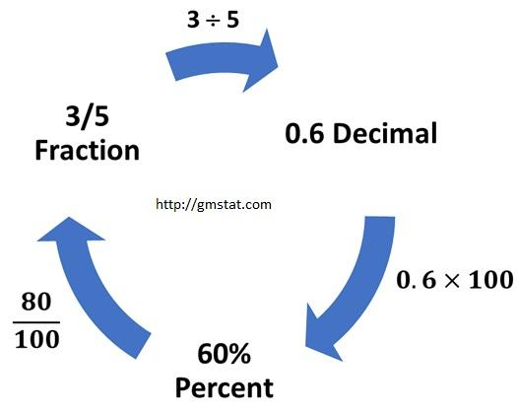
Rational Numbers: Converting between Forms
You may be asked to convert between all three forms of rational numbers we have reviewed.
Practice⁹³ for converting between percent, fraction, and decimal forms.
Figure 36. Fraction to decimal to percent. Adapted from Percents, Fractions, and Decimals Made Easy by Muhammad Imdad Ullah, retrieved from https://itfeature.com/misc-articles/percentages-fractions-and-decimals/. Copyright 2025 by Statistics and Data Analyst.

Slide 79
Rational Numbers: Comparing⁹⁴
When comparing rational numbers, you will need to know the following symbols:
Greater than >
Less than <
Equal to =
Find my tips for understanding and remembering the greater than and less than signs on the next two slides.
☆ Pro Tip ☆
Since you can use a calculator on the TEAS, I recommend converting everything to decimals, then comparing them. Make sure you use the original form in your answer, though.

Slide 80
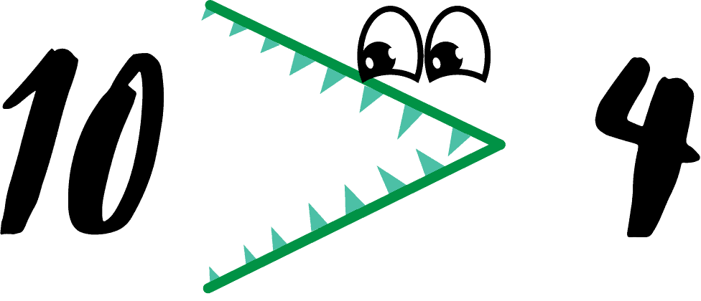

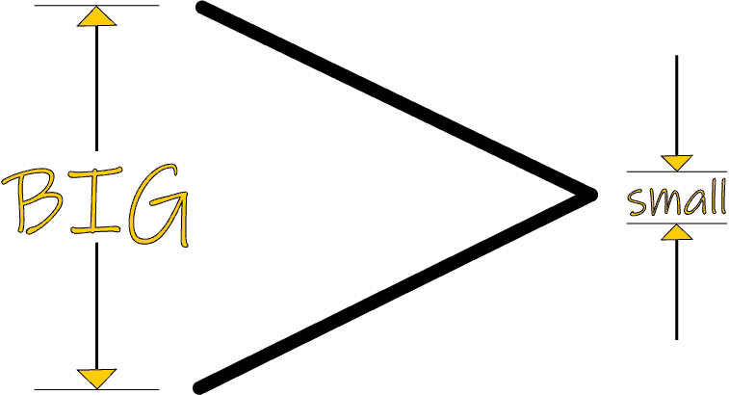
Rational Numbers: Comparing
Some of you may have learned that the alligator eats the bigger number.
Some of you may have learned that the bigger side of the inequality goes with the bigger number.
Figures 37 & 38. Greater than and less than alligators. Adapted from Remembering the Greater Than Sign & Less Than Sign by Jay Willis, 2020, retrieved from https://www.mometrix.com/blog/remembering-the-greater-than-sign-less-than-sign/.
Figure 39. Open ends. Adapted from Remembering the Greater Than Sign & Less Than Sign by Jay Willis, 2020, retrieved from https://www.mometrix.com/blog/remembering-the-greater-than-sign-less-than-sign/.

Slide 81

Rational Numbers: Comparing
Some of you may not know which symbol is which though.
Remember that the less than symbol looks like an L.
I hope this helps!
Figure 40. Less than symbol. Adapted from Remembering the Greater Than Sign & Less Than Sign by Jay Willis, 2020, retrieved from https://www.mometrix.com/blog/remembering-the-greater-than-sign-less-than-sign/.

Slide 82
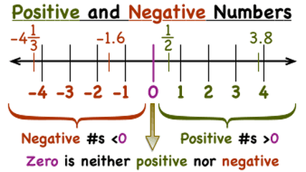
Rational Numbers: Ordering⁹⁵
Rational numbers can be ordered from least to greatest (or greatest to least) by placing them where they belong on a number line.
When working with fractions, it is best to
convert them to a common denominator.
When working with numbers in multiple
forms (decimals, fractions, and percents),
convert the fractions to decimals and the
percents to decimals so that you only have
decimals.
Practice⁹⁶ for comparing and ordering rational numbers (answer key⁹⁷).
Figure 41. Number line. Adapted from Unit 3.2 - Adding Rational Numbers, retrieved from https://the-world-is-my-classroom.weebly.com/.

Slide 83
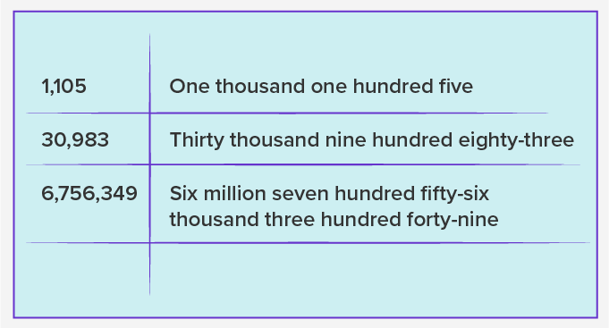
Rational Numbers: Word Form
In addition to writing numbers with numbers, we can write them with words. When writing numbers in word form, you must follow specific rules.
Writing whole numbers with words⁹⁸
Writing decimal numbers with words⁹⁹
Only use the word “and” to represent a decimal point, and only use hyphens in words between twenty-one and ninety-nine.
Figure 42. Writing numbers in words. Adapted from Number Words - Definition, Examples, Practice Problems, FAQs, retrieved from https://www.splashlearn.com/math-vocabulary/number-sense/number-words.

Slide 84
Rational Numbers: Word Form
Practice for writing whole numbers¹⁰⁰ (answers on the next slide) and decimal numbers¹⁰¹ (answer key¹⁰²) in word form.
Note:
When I write numbers in words, I usually place a comma between the periods. (I would write the first number in the image to the right as “one thousand, one hundred five.”) I’m not sure if the TEAS use the commas between the commas.
Figure 42. Writing numbers in words. Adapted from Number Words - Definition, Examples, Practice Problems, FAQs, retrieved from https://www.splashlearn.com/math-vocabulary/number-sense/number-words.

Slide 85
Rational Numbers: Word Form Answers
Answers to Writing Whole Numbers in Words:
Part A:
Sixty-eight million, forty-six thousand, one hundred ninety-seven
Fifty-four million, five hundred ninety-three thousand, twenty-six
Ninety-six million, one hundred fifty-nine thousand, four hundred seventy-eight
Twenty-five million, eight hundred twenty thousand, nine hundred thirty-six
Thirteen million, seven hundred thirty-two thousand, five hundred forty-nine
Part B:
17,089,263
96,173,852
29,304,615
35,617,082
51,986,470
Please let me know if I made any mistakes!

Slide 86
Rational Numbers: Reminder
That’s the end of this portion of the workshop.
If you’d like to return to the Table of Contents slide, click here.

Slide 87

THE END!
(of Part 1)
Figure 43. Gatsby cheers. Retrieved from https://imgur.com/gallery/7MrEHC4.
Make sure you check out Part 2: Algebra!

Slide 88
References Page 1
“Intro to rational & irrational numbers” (video). Khan Academy. Accessed June 26, 2025. https://www.khanacademy.org/math/cc-eighth-grade-math/cc-8th-numbers-operations/cc-8th-irrational-numbers/v/introduction-to-rational-and-irrational-numbers
Math with Mr. J. (2020, March 31). Prime and Composite Numbers | Math with Mr. J [Video]. YouTube. https://www.youtube.com/watch?v=ydm2cxacPIM
“Prime factorization” (video). Khan Academy. Accessed June 26, 2025. https://www.khanacademy.org/math/pre-algebra/pre-algebra-factors-multiples/pre-algebra-prime-factorization-prealg/v/prime-factorization
Math with Mr. J. (2020, April 13). Divisibility Rules (2, 3, 4, & 5) [Video]. YouTube. https://www.youtube.com/watch?v=cqnYjR46T58
Math with Mr. J. (2020, April 13). Divisibility Rules (6, 7, 8, 9, & 10) [Video]. YouTube. https://www.youtube.com/watch?v=OPz99FFbo7M
Prime Factors (A). (2025). Math-Drills.com. https://math-drills.com/numbersense/prime_factors_tree_004144_001.1675735321.pdf

Slide 89
References Page 2
“Least common multiple” (video). Khan Academy. Accessed June 26, 2025. https://www.khanacademy.org/math/cc-sixth-grade-math/cc-6th-expressions-and-variables/cc-6th-lcm/v/least-common-multiple-exercise
Math with Mr. J. (2020, January 13). Greatest Common Factor | How to Find the Greatest Common Factor (GCF) [Video]. YouTube. https://www.youtube.com/watch?v=crWLFqOQtBA
LCM and GCF Worksheets. (2025). OnlineMathLearning.com. https://www.interactive.onlinemathlearning.com/share/worksheets/lcm-gcf-worksheet.pdf
Math with Mr. J. (2020, January 12). What is Absolute Value? | Absolute Value Examples | Math with Mr. J [Video]. YouTube. https://www.youtube.com/watch?v=LnfhdtjcpVY
Absolute values. (2025). K5 Learning. https://www.k5learning.com/worksheets/math/grade-5-integers-absolute-value-a.pdf
Math with Mr. J. (2021, January 8). Adding Integers | How to Add Positive and Negative Integers [Video]. YouTube. https://www.youtube.com/watch?v=CfkaifC7tGY
Math with Mr. J. (2022, June 21). Subtracting Integers Explained | How to Subtract Integers | Math with Mr. J [Video]. YouTube. https://www.youtube.com/watch?v=5sNqgCK7MG4

Slide 90
References Page 3
Adding Integers (A). (2025). Math-Drills.com. https://math-drills.com/integers/integers_addition_negative_parentheses_-50to50_001.1694538938.pdf
Math Antics. (2014, November 24). Math Antics - Integer Multiplication & Division [Video]. YouTube. https://www.youtube.com/watch?v=K_tPbVPfHgk
Multiplying and Dividing Integers (A). (2025). Math-Drills.com. https://math-drills.com/integers/integers_06multdiv_01mixed_01range09_01questions025_001.1694118995.pdf
“Intro to exponents” (video). Khan Academy. Accessed June 26, 2025. https://www.khanacademy.org/math/cc-sixth-grade-math/x0267d782:cc-6th-exponents-and-order-of-operations/cc-6th-exponents/v/introduction-to-exponents
Math with Mr. J. (2021, October 12). Multiplying Exponents with the Same Base | Exponent Rules | Math with Mr. J [Video]. YouTube. https://www.youtube.com/watch?v=OY52uslSxWs
Math with Mr. J. (2021, October 20). Dividing Exponents with the Same Base | Exponent Rules | Math with Mr. J [Video]. YouTube. https://www.youtube.com/watch?v=Ei817TVioBU
Math with Mr. J. (2021, October 13). Power of a Power | Exponent Rules | Math with Mr. J [Video]. YouTube. https://www.youtube.com/watch?v=ox06qIV2c1U

Slide 91
References Page 4
MooMooMath and Science. (2021, November 10). Power of a Product- Math [Video]. YouTube. https://www.youtube.com/watch?v=lhfd1_-GFDg
Math with Mr. J. (2020, April 7). Fractions with Exponents | Powers of Fractions [Video]. YouTube. https://www.youtube.com/watch?v=Xa95eZ9fCrQ
Math with Mr. J. (2020, January 12). Negative Exponents | How to Solve Negative Exponents [Video]. YouTube. https://www.youtube.com/watch?v=wSracfsnFI8
Mixed Exponent Rules (A). (2025). Math-Drills.com. https://math-drills.com/algebra/algebra_exponent_rules_basic_mixed_positive_001.1739984937.pdf
Math with Mr. J. (2021, July 8). What Are Square Roots? | Math with Mr. J [Video]. YouTube. https://www.youtube.com/watch?v=yICR9PiW340
Squares and Square Roots (A). Math-Drills.com. https://math-drills.com/numbersense/squares_and_square_roots_001.1675735321.pdf
Math with Mr. J. (2022, October 26). What’s the Commutative Property? | Math with Mr. J [Video]. YouTube. https://www.youtube.com/watch?v=dHjT4d4oHyc
Math with Mr. J. (2022, October 31). What’s the Associative Property? | Math with Mr. J [Video]. YouTube. https://youtu.be/AZpS-im4_Kk?si=xhYNdE1Ns6qCuocd

Slide 92
References Page 5
Math with Mr. J. (2022, November 9). What’s the Identity Property? | Identity Property of Addition and Multiplication | Math with Mr. J [Video]. YouTube. https://www.youtube.com/watch?v=kaKi4EpsFqc
Math Antics. (2016, February 20). The Distributive Property in Arithmetic [Video]. YouTube. https://www.youtube.com/watch?v=VZ0jG3W53nE
Math with Mr. J. (2022, November 11). Inverse Property of Addition | Additive Inverse | Math with Mr. J [Video]. YouTube. https://www.youtube.com/watch?v=QaEqrqz4EYs
Math with Mr. J. (2022, November 11). Inverse Property of Multiplication | Multiplicative Inverse (Reciprocal) | Math with Mr. J [Video]. YouTube. https://www.youtube.com/watch?v=1P_xR-31F8s
“Intro to order of operations” (video). Khan Academy. Accessed June 26, 2025. https://www.khanacademy.org/math/cc-seventh-grade-math/cc-7th-negative-numbers-multiply-and-divide/cc-7th-order-of-operations/v/introduction-to-order-of-operations
Order of Operations (A). (2025). Math-Drills.com. https://math-drills.com/orderofoperations/ooo_integers_foursteps_positive_pemdas_001.1675735326.pdf
MATH-N-ROLL. (2021, November 28). Decimal Place Value. Grade 5 [Video]. YouTube. https://www.youtube.com/watch?v=u0mREOY0xso

Slide 93
References Page 6
Math with Mr. J. (2019, October 6). Step by Step Rounding | Whole Number Rounding [Video]. YouTube. https://www.youtube.com/watch?v=KkswD4iPyO0
Math with Mr. J. (2021, July 21). How to Round Decimals | Math with Mr. J [Video]. YouTube. https://www.youtube.com/watch?v=P7ozJW8LSxw
Rounding Numbers (A). (2025). Math-Drills.com. https://math-drills.com/numbersense/rounding_10000_us_001.1360997475.pdf
Rounding Decimals (A). (2025). Math-Drills.com. https://math-drills.com/decimal/decround_various_various_001.1417828262.pdf
Math with Mr. J. (2020, October 21). Estimating Whole Number Sums & Differences | Addition & Subtraction Estimation | Math with Mr. J [Video]. YouTube. https://www.youtube.com/watch?v=EvQf38lnAJc
Math with Mr. J. (2020, November 6). Estimating Whole Number Products | Multiplication Estimation | Math with Mr. J [Video]. YouTube. https://www.youtube.com/watch?v=mBWr8c0Lsx4
Math with Mr. J. (2020, November 23). Estimating Decimal Division | Math with Mr. J [Video]. YouTube. https://www.youtube.com/watch?v=_EYGStYBvEo
Estimation: Nearest Thousand. (2025). Math Worksheets 4 Kids. https://www.mathworksheets4kids.com/estimation/sum-difference/nearest-thousand-sum1.pdf

Slide 94
References Page 7
Estimate the Product. (2025). Math Worksheets 4 Kids. https://www.mathworksheets4kids.com/estimation/product-quotient/nearest-ten-2by1digit1.pdf
Estimate the Quotient. (2025). Math Worksheets 4 Kids. https://www.mathworksheets4kids.com/estimation/product-quotient/mcq-quotient1.pdf
MooMooMath and Science. (2018, February 8). Scientific Notation ( An introduction ) [Video]. YouTube. https://www.youtube.com/watch?v=is2mZG3dXJA
“Scientific notation example: 0.0000000003457” (video). Khan Academy. Accessed June 26, 2025. https://www.khanacademy.org/math/cc-eighth-grade-math/cc-8th-numbers-operations/cc-8th-scientific-notation/v/scientific-notation-i
Scientific Notation (A). (2025). Math-Drills.com. https://math-drills.com/numbersense/scientific_notation_scientific_to_ordinary_001.1366065256.pdf
The Magic of Math. (2022, December 31). Converting Scientific Notation to Standard Form | 8.EE.A.3 💗💙 [Video]. YouTube. https://www.youtube.com/watch?v=qImdDFHZnMI
Scientific Notation (A). (2025). Math-Drills.com. https://math-drills.com/numbersense/scientific_notation_ordinary_to_scientific_001.1366065300.pdf

Slide 95
References Page 8
MooMooMath and Science. (2020, November 16). Scientific Notation-Adding and Subtracting [Video]. YouTube. https://www.youtube.com/watch?v=bf-eJaNJxc0
Scientific Notation Operations. (2025). OnlineMathLearning.com. https://www.interactive.onlinemathlearning.com/share/worksheets/add-subtract-scientific-notation-worksheet.pdf
The Organic Chemistry Tutor. (2018, February 8). Scientific Notation - Multiplication and Division [Video]. YouTube. https://www.youtube.com/watch?v=yX6Mq9whsX0
Multiplying with Scientific Notation. (2023). Common Core Sheets. https://www.commoncoresheets.com/pdfs/76/worksheet.pdf?sheet_language=english&version=1&&sheet_layout%5Bpages%5D%5Bws%5D=1&sheet_layout%5Bpages%5D%5Bans%5D=1&sheet_layout%5Bsheet_language%5D=english&sheet_layout%5Btitle%5D=&sheet_layout%5Binstructions%5D=&sheet_layout%5Bnumber_of_problems%5D=&sheet_layout%5Bdue_date%5D=&sheet_layout%5Binclude_standard%5D=0&sheet_layout%5Bccss%5D=8ee4&sheet_layout%5Bfont_family%5D=&sheet_layout%5Bfont_size%5D=12&sheet_layout%5Bmargin_bottom%5D=&sheet_layout%5Banswer_column_display%5D=1&sheet_layout%5Bproblem_number_display%5D=1&sheet_layout%5Borientation%5D=portrait&
Scientific Notation Operations. (2025). OnlineMathLearning.com. https://www.interactive.onlinemathlearning.com/share/worksheets/divide-scientific-notation-worksheet.pdf

Slide 96
References Page 9
Math with Mr. J. (2024, January 12). Fractions | Understanding the Language | Math with Mr. J [Video]. YouTube. https://www.youtube.com/watch?v=38KfKBpwAv4
Math with Mr. J. (2020, January 6). Mixed Numbers to Improper Fractions | Math with Mr. J [Video]. YouTube. https://www.youtube.com/watch?v=96NOYcnmThU
Convert mixed numbers to improper fractions. (2025). K5 Learning. https://www.k5learning.com/worksheets/math/grade-4-mixed-numbers-to-improper-fractions-harder-a.pdf
Math with Mr. J. (2020, January 6). Mixed Numbers to Improper Fractions | Math with Mr. J [Video]. YouTube. https://www.youtube.com/watch?v=EpXCr2iax5E
Convert improper fractions to mixed numbers. (2025). K5 Learning. https://www.k5learning.com/worksheets/math/grade-5-improper-fractions-to-mixed-numbers-a.pdf
Math with Mr. J. (2019, December 8). Simplifying Fractions Step by Step | How to Simplify Fractions [Video]. YouTube. https://www.youtube.com/watch?v=oFVzcnJfYkg&t=240s
Simplify proper fractions (harder). (2025). K5 Learning. https://www.k5learning.com/worksheets/math/grade-6-simplifying-fractions-hard-a.pdf
Math with Mr. J. (2020, June 17). Adding Fractions with Common Denominators (Step by Step) | Math with Mr. J [Video]. YouTube. https://www.youtube.com/watch?v=MZmENadGcK0

Slide 97
References Page 10
Math with Mr. J. (2020, June 17). Subtracting Fractions with Common Denominators (Step by Step) | Math with Mr. J [Video]. YouTube. https://www.youtube.com/watch?v=VTCOHFJOAA8
Math Antics. (2012, April 17). Math Antics - Common Denominator LCD [Video]. YouTube. https://www.youtube.com/watch?v=pZEmFSP3Z0I
Math with Mr. J. (2021, August 17). Adding and Subtracting Fractions with Unlike Denominators | Math with Mr. J [Video]. YouTube. https://www.youtube.com/watch?v=XsW8HJutIgM
Adding and Subtracting Two Fractions (A). (2025). Math-Drills.com. https://math-drills.com/fractions/fractions_addsub_improper_like_easy_001.1698465724.pdf
Math with Mr. J. (2019, November 5). Multiplying Fractions by Fractions | How to Multiply Fractions | 5th Grade Math [Video]. YouTube. https://www.youtube.com/watch?v=H3ZY65icKmw
Math with Mr. J. (2019, November 5). Dividing Fractions by Fractions | How to Divide a Fraction by a Fraction [Video]. YouTube. https://www.youtube.com/watch?v=yKCBspYtrSU&list=PLiT3pCvK_cfWKCdp0km0a1_2Ag6xYvrv1&index=3
Math Antics. (2012, April 17). Math Antics - Dividing Fractions [Video]. YouTube. https://www.youtube.com/watch?v=4lkq3DgvmJo

Slide 98
References Page 11
Multiplying and Dividing Proper and Improper Fractions (A). (2025). Math-Drills.com. https://math-drills.com/fractions/fractions_multdiv_001.1698465830.pdf
Math with Mr. J. (2022, July 26). An Intro to Ratios | What is a Ratio? | Understanding Ratios | Math with Mr. J [Video]. YouTube. https://www.youtube.com/watch?v=GnIJQkzYWWs
“Worked example: Solving proportions” (video). Khan Academy. Accessed June 30, 2025. https://www.khanacademy.org/math/cc-seventh-grade-math/cc-7th-ratio-proportion/cc-7th-write-and-solve-proportions/v/find-an-unknown-in-a-proportion
Solving Proportions. (2025). Math Worksheets 4 Kids. https://www.mathworksheets4kids.com/proportion/solving/proportion-level1-1.pdf
“Solving unit rate problem” (video). Khan Academy. Accessed June 30, 2025. https://www.khanacademy.org/math/cc-sixth-grade-math/x0267d782:cc-6th-rates-and-percentages/cc-6th-rates/v/finding-unit-rates
Finding Unit Rate. (2025). Super Teacher Worksheets. https://www.superteacherworksheets.com/unit-rate/finding-unit-rate_FGUTR.pdf
Math Antics. (2012, October 30). Math Antics - What Are Percentages? [Video]. YouTube. https://www.youtube.com/watch?v=JeVSmq1Nrpw

Slide 99
References Page 12
“Solving percent problems” (video). Khan Academy. Accessed June 30, 2025. https://www.khanacademy.org/math/cc-seventh-grade-math/cc-7th-fractions-decimals/cc-7th-percent-word-problems/v/solving-percent-problems
MooMooMath and Science. (2024, January 14). Solving PERCENT PROBLEMS using IS over OF [Video]. YouTube. https://www.youtube.com/watch?v=S12-U7Lz7Ac
Percent Calculations (A). (2025). Math-Drills.com. https://math-drills.com/percentsworksheets/percents_calculate_part_allpercents_regular_wholenumbers_001.1675735328.pdf
Math with Mr. J. (2021, April 30). Percent of Change | Percent Increase and Decrease | Math with Mr. J [Video]. YouTube. https://www.youtube.com/watch?v=jAcDJDjQk2g
Percentage Increase/Decrease (A). (2025) Math-Drills.com. https://math-drills.com/percentsworksheets/percents_increase_decrease_whole_allpercents_001.1588420059.pdf
Math with Mr. J. (2020, April 20). Converting Decimals to Percents [Video]. YouTube. https://www.youtube.com/watch?v=NJ31kZey01I
Math with Mr. J. (2020, April 22). Converting Percents to Decimals [Video]. YouTube. https://www.youtube.com/watch?v=jPmno8_2zi0

Slide 100
References Page 13
Percents and decimals conversion over 100. (2025). K5 Learning. https://www.k5learning.com/worksheets/math/grade-6-decimals-to-percents-vice-versa-over-100-percent-a.pdf
Math with Mr. J. (2020, April 9). Converting Decimals to Fractions (Tenths, Hundredths, and Thousandths) [Video]. YouTube. https://www.youtube.com/watch?v=qesj2jpktaE
Converting Fractions to Decimals (A). (2025). Math-Drills.com. https://math-drills.com/fractions/common_fractions_convert_to_decimal_001.1675735262.pdf
Converting Decimals to Fractions (A). (2025). Math-Drills.com. https://math-drills.com/decimal/decimals_convert_terminating_only_decimals_to_fractions_001.1479311849.pdf
Math with Mr. J. (2020, April 6). Converting Fractions to Percents [Video]. YouTube. https://www.youtube.com/watch?v=tZMj0OX5WJ
Converting Fractions to Percentages. (2025). MathMonks.com. https://mathmonks.com/wp-content/uploads/2022/06/Converting-Fractions-to-Percentages-Worksheet.pdf
Math with Mr. J. (2020, April 21). Converting Percents to Fractions [Video]. YouTube. https://www.youtube.com/watch?v=gUlbT4-NEdg
Converting Percentages to Fractions. (2025). MathMonks.com. https://mathmonks.com/wp-content/uploads/2022/06/Converting-Percentages-to-Fractions-Worksheet.pdf

Slide 101
References Page 14
Fraction, Decimal, and Percent Conversion. (2025). MathMonks.com. https://mathmonks.com/wp-content/uploads/2021/05/6th-Grade-Fractions-Decimals-and-Percents-Worksheets.pdf
Math with Mr. J. (2024, January 11). Comparing Rational Numbers | Math with Mr. J [Video]. YouTube. https://www.youtube.com/watch?v=7g3O_nqyWKg
Scam Squad. (2021, June 3). Order Rational Numbers from Least to Greatest [Video]. YouTube. https://www.youtube.com/watch?v=yVIwZXzLyUQ
Compare and Order Decimals, Percents, and Fractions. (2025. EasyTeacherWorksheets.com. https://www.easyteacherworksheets.com/pages/pdf/math/greaterthan/decimalspercents/4.html
Answer Key - Compare and Order Decimals, Percents, and Fractions. (2025). EasyTeacherWorksheets.com. https://www.easyteacherworksheets.com/pages/pdf/math/greaterthan/decimalspercents/6.html
Math with Mr. J. (2020, August 31). How to Write Whole Numbers in Word Form | Math with Mr. J [Video]. YouTube. https://www.youtube.com/watch?v=zSg4Pzq8jns
Math with Mr. J. (2020, September 9). How to Write Decimals in Word Form | Math with Mr. J [Video]. YouTube. https://www.youtube.com/watch?v=8Ac6W-NWd9M
Numbers in Words | 8-Digit (2025). TutoringHour.com. https://www.tutoringhour.com/preview/numbers-in-words/multi-digit/8-digit.pdf

Slide 102
References Page 15
Numbers in Words | Decimals. (2025). TutoringHour.com. https://www.tutoringhour.com/preview/numbers-in-words/decimals/revision-1.pdf
Numbers in Words | Decimals Answer Key. (2025). TutoringHour.com. https://www.tutoringhour.com/preview/numbers-in-words/decimals/revision-1-key.pdf

